Slide 1
A Study and Analysis of High-Order Euler Equation Solver LAGHOS
Jonathan Lijewski, jlijewski@ufl.edu
Nikodem Gazda, ngazda@ufl.edu

Slide 2
Summary (2 slides)
Background
Gave overview on LAGHOS
Explained the problems within LAGHOS that we ran on HiPerGator
Explained the context of the results LAGHOS calculates on each run
Code Review
Explained the structure of the code as well as how it was parallelized with both MPI and OpenMP examples
Literature Review (2 papers)
Gave background context for each paper (purpose, relevance, and hardware) and reviewed the results for both papers
Ported results to HiPerGator, compared to published results
Results performed comparably to the first paper, running a little higher or lower in each plot, but our results showed better performance for the Forces operator problem.
Results performed at the capacity of ~64 GPUs in the 2nd paper in one test, given our problem size of ~200M, and were outperformed by each configuration of the paper in the second test
Ran MPI, MPI+OpenMP, and CUDA code on HiPerGator, best performance with MPI was with 1 node, 8 tasks, and 4 CPUs/task, CUDA was best performing overall
Please see report for a more detailed analysis on the results.

Slide 3
Summary (2 slides)
Gprof Profiling
Showed the majority of time was spent in the MFEM library, which is where we decided to edit the code.
Explained how the function calls were consistent among different configurations of MPI runs because the number of CPUs stayed the same
Nvprof Profiling
Laghos was run with the CUDA backend enabled on HiperGator by requesting GPU resources.
Nvprof showed extensive use of the CUDA kernels in the MFEM library used to replace the MPI functions.
A large amount of time was also spent allocating memory (malloc/calloc)
Vtune Profiling
Laghos with OpenMP backend enabled was run off of HigerGator, on a local intel machine in WSL (Windows Subsystem for Linux). The problem ran with 15 threads. Specifically focused on HotSpots and memory consumption
Results were comparable to Gprof, the hotspots were some of the same MFEM functions
Individual threads spent most of the time in vector addition functions in MFEM.
Changed OpenMP Code
In the MFEM Library, the vector addition functions were some of the only places where OpenMP code could be seen and altered.
These functions used default static scheduling for the OpenMP parallel loop, this was changed to dynamic scheduling, and the chunk size was changed from the default (N/numThreads) to constant values to see difference in performace
Dynamic scheduling performed slightly worse than static, possibly due to overhead or the regular workload of the problems run in Laghos
Demo (Next slide)
Demo of MPI version of Laghos and MPI+OpenMP version (OpenMP enabled through the MFEM library)

Slide 4
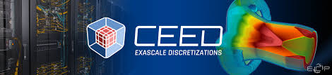
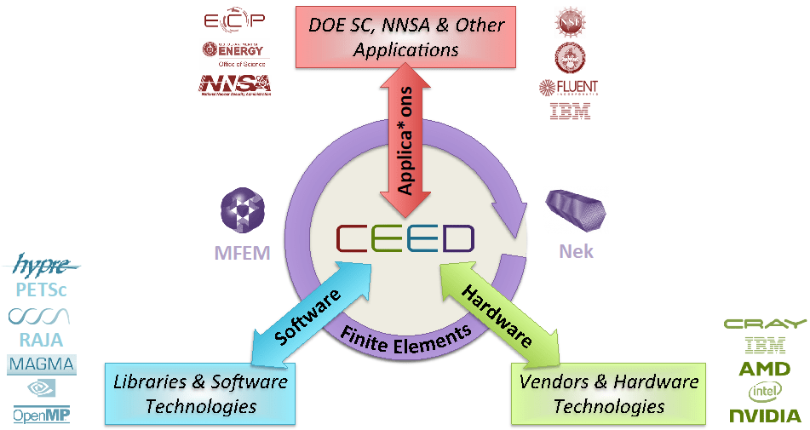
LAGHOS Overview
LAGHOS is a miniapp that is part of a larger software suite, CEED ( Center for Efficient Exascale Discretizations)
LAGHOS in particular is used to describe high order Euler equations of gas dynamics in a Lagrangian frame into a discrete format.
Given a system of high order differential equations, LAGHOS will construct matrices for the velocity, energy, and force of the system and solve them to create a mesh of the resulting discrete system.

Slide 5
LAGHOS contains two main modes for completing the discretization, partial assembly and full assembly.
Partial assembly involves taking advantage of a sum factorization method and the local version of the matrices to precompute entries into the resultant matrix, saving in data storage and memory transfers.
The full assembly in comparison works with the global version of the matrices, and is contained in compressed sparse row format.
Both methods utilize the MFEM C++ library to complete the calculations and construct the finite element meshes.
LAGHOS maintains support for GPUs and additional software models such as CUDA and OpenMP through the use of the MFEM library.

Slide 6
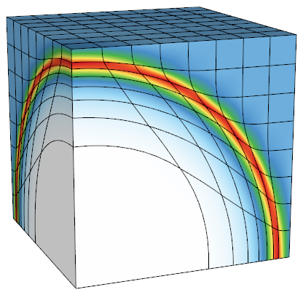
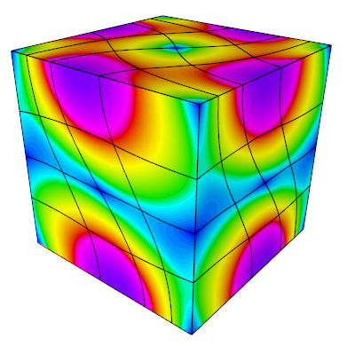
Problem Exploration
Sedov Blast Problem:
Main problem of interest for LAGHOS
Test case in numerical hydrodynamics that simulates the radial expansion of a high-energy explosion
Serves as a benchmark to evaluate the accuracy and efficiency for modeling shock physics and complex flow dynamics in explosions
mpirun -np 8 ./laghos -p 1 -dim 2 -rs 3 -tf 0.8 -pa
Taylor-Green Problem:
Benchmark in computational fluid dynamics that simulates how vortex structures change in an incompressible flow
Test case to assess the accuracy and efficiency of simulating vortex dynamics and turbulence
mpirun -np 8 ./laghos -p 0 -dim 2 -rs 3 -tf 0.75 -pa

Slide 7
Result Metrics Explanation
LAGHOS outputs its own results in units of time (s) and rate (megadofs x cg_iterations / second), where megadofs are millions of nodes that need to be computed:
The inversion of the global kinematic mass matrix (CG H1)
Represents the mass properties of the system approximated into finite elements
Inversion is needed to solve the system of equations for the problem
2. The force operator evaluation from degrees of freedom to quadrature points
Calculates the forces acting on the system at any given time
Result from the interactions between the velocities and positions of each node
Quadrature points are points in the system where the function values are computed and used to approximate the integrals for the solution
3. The physics kernel in quadrature points (UpdateQuadData)
Time and rate for updating the physical quantities at the quadrature points for each element of the mesh and for each timestep in the simulation

Slide 8
Approach
From where are you downloading the code (URLs of websites, etc.)?
Downloading code from LAGHOS Github
What code are available? e.g., serial, MPI only, MPI+OpenMP, etc.
Serial+MPI code available, both to be studied and ported to HiPerGator. OpenMP is available through the MFEM library, which is used for calculations.
What are your proposed tasks?
Read through the downloaded code and review its features, including parallelization
Read relevant works published on the solver and synthesize their findings
Port the code to HiPerGator
Compare the ported code to other studies done on LAGHOS

Slide 9
Approach (cont.)
Any value-added tasks? (e.g., extensive profiling with Score-P, design-space exploration as “stretched goals”)
Profile the code with gprof, nvprof, vtune
Modify the code and analyze how our modifications improve/worsen its performance
Changes from project proposal and progress slides:
Specified gprof as chosen profiler, also used nvprof and vtune
Specified code in the MFEM library will be altered by optimizing OpenMP code

Slide 10
Code Review
3 main files: `laghos.cpp`, `laghos_solver.cpp`, and `laghos_assembly.cpp`
`laghos.cpp` contains the driver with the main computations starting around line 609
In each time step, the system of equations are defined and solved by the class `LagrangianHydroOperator`, defined around line 544 of `laghos.cpp`
Actually implemented in `laghos_solver.cpp`
All quadrature-based computations are performed in the function `UpdateQuadratureData` in `laghos_solver.cpp`
`LagrangianHydroOperator::Mult` constructs and solves the final system of eq.
The computations for all mass matrices are performed by the MFEM
library, e.g., classes `MassIntegrator` and `VectorMassIntegrator`
When partial assembly is used, the main computational kernels are the `Mult` functions of the classes `MassPAOperator` and `ForcePAOperator`, implemented in `laghos_assembly.cpp`

Slide 11
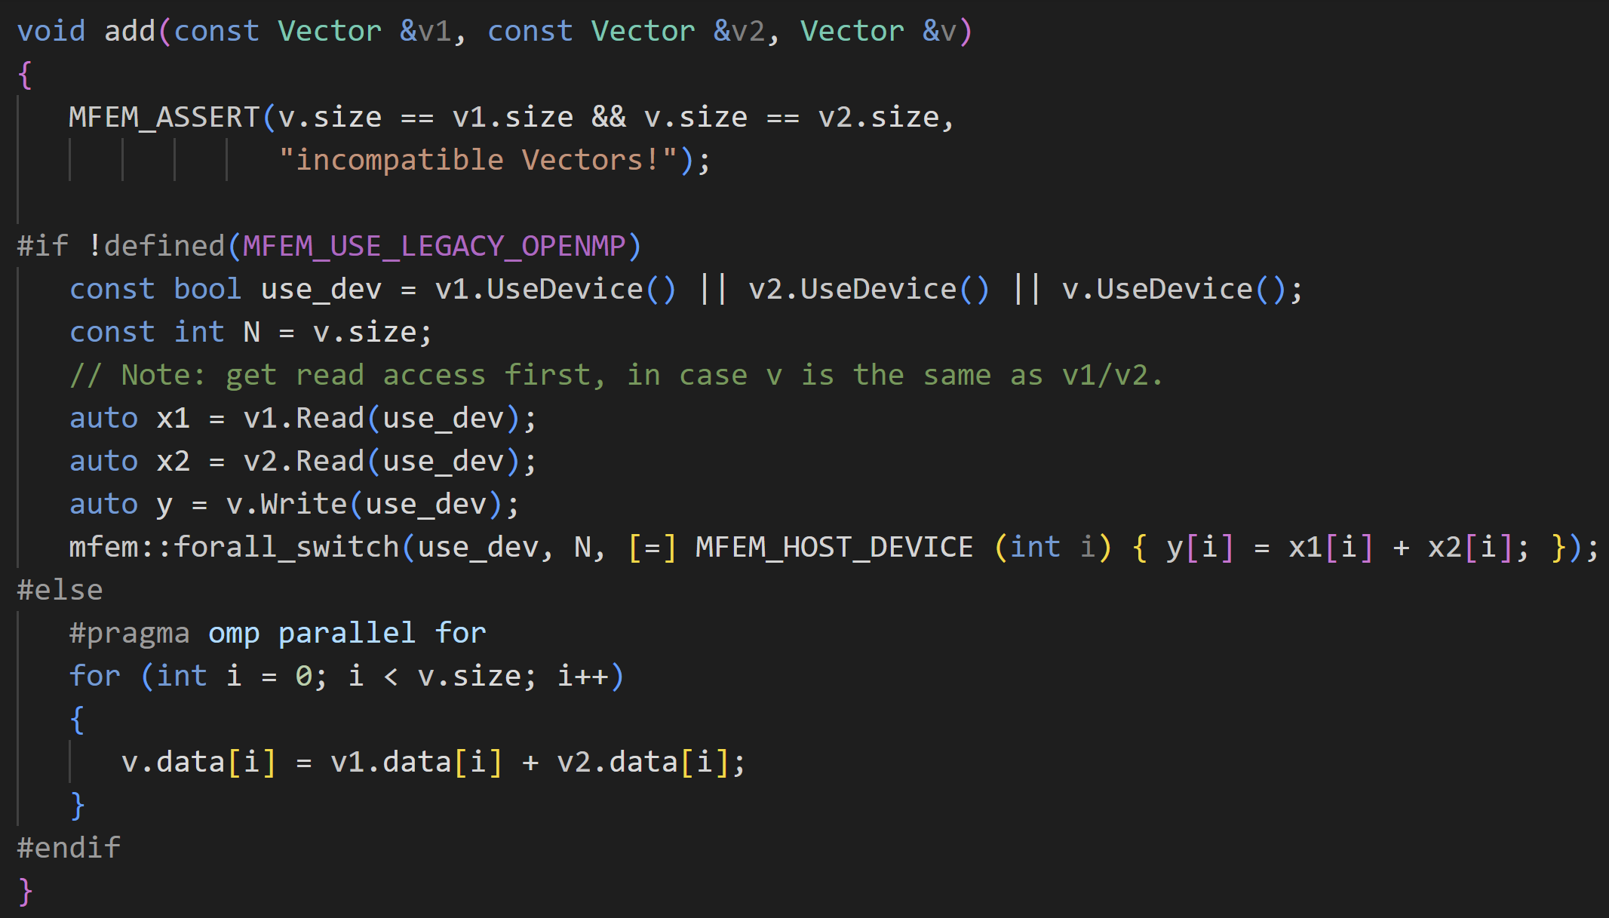
Code Review
Serial vs OpenMP—Same add operation, split over different resources

Slide 12
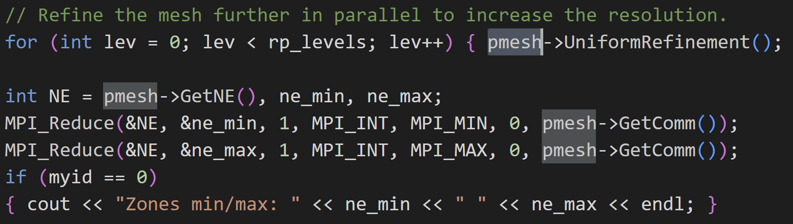
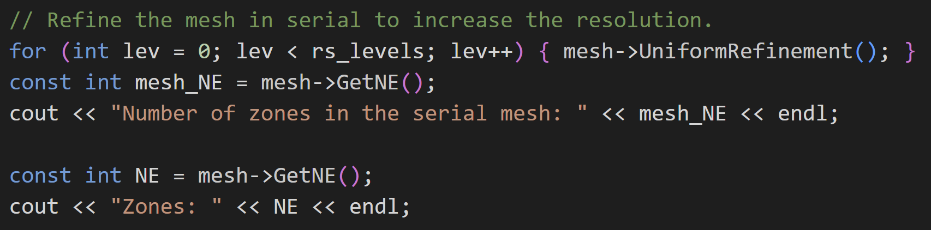
Code Review
Parallel
Serial vs MPI—Same mesh operation
MPI uses pmesh to split workload across available processors and uses MPI_Reduce to combine results
Serial

Slide 13
Literature Review: Paper 1
Title: CEED-MS8:Initial Integration of CEED Software in ECP Applications
Purpose for technical report:
Detail initial integration of CEED software into the first several selected Exascale Computing Project (ECP) applications
Evaluate various approaches for GPU acceleration
Relevance:
Introduces the integration of OCCA within MFEM library, allowing GPU to handle computations on vector operations, integrators, mixed finite element methods, and more
Taylor-Green Problem
Hardware:
Ray machine at Lawrence Livermore National Laboratory (LLNL)
2 IBM Power8 CPUs per node, each of which containing 10 cores with 8 threads per core
4 Tesla P100 GPUs
All the CPU tests were run on one node with 16 and 64 MPI tasks in 2D and 3D, respectively. The GPU calculations use only one of the GPUs.

Slide 14
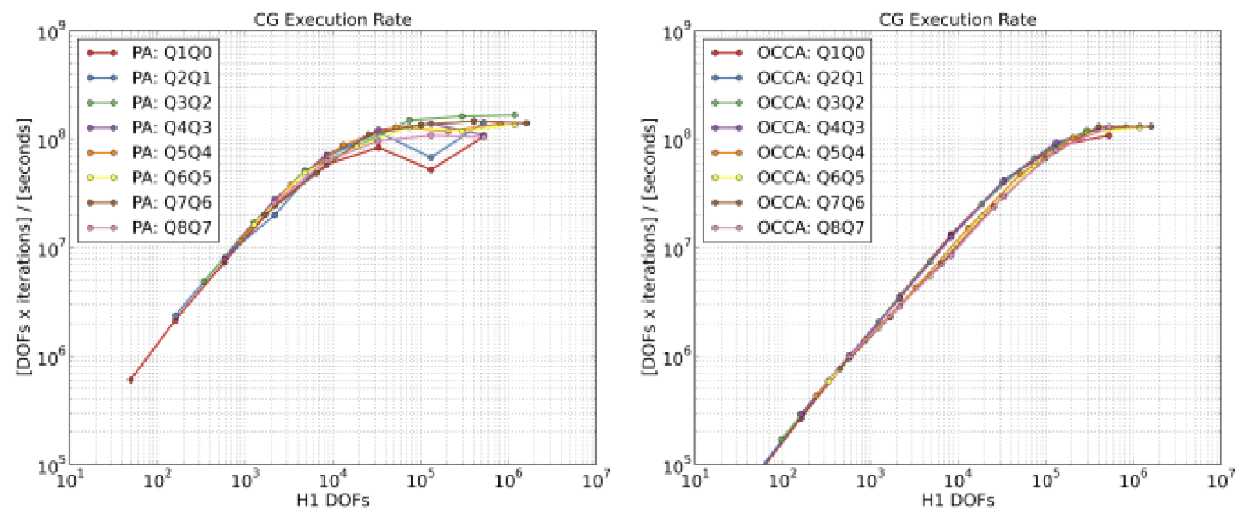
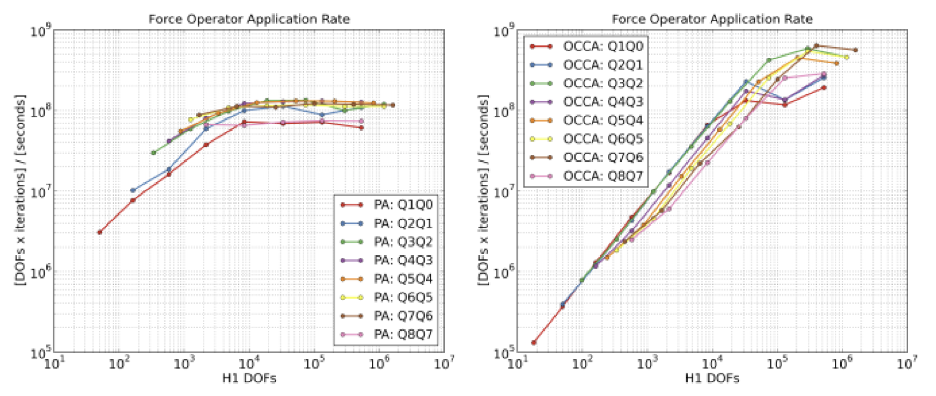
Literature Review: Paper 1
Figure 1: The inversion of the global kinematic mass matrix (CG H1). CPU left, GPU right.
Figure 2: Force operator evaluation. Left, CPU, right, GPU.
The labels “denote the finite element spaces used for the corresponding result set, e.g., Q4Q3 means continuous kinematic space of type Q4 and discontinuous thermodynamic set of type Q3 on each cell” [1]

Slide 15
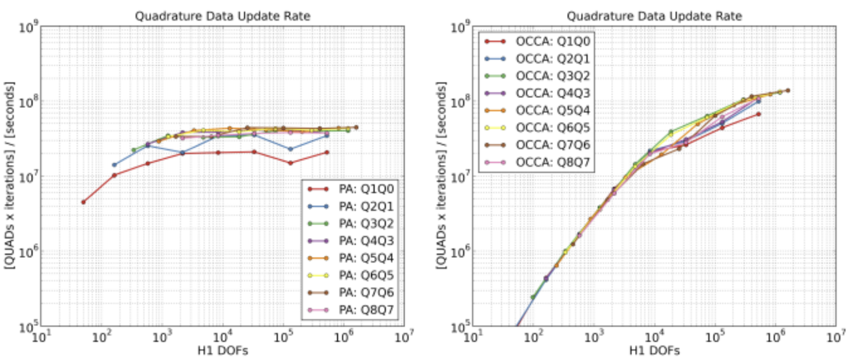
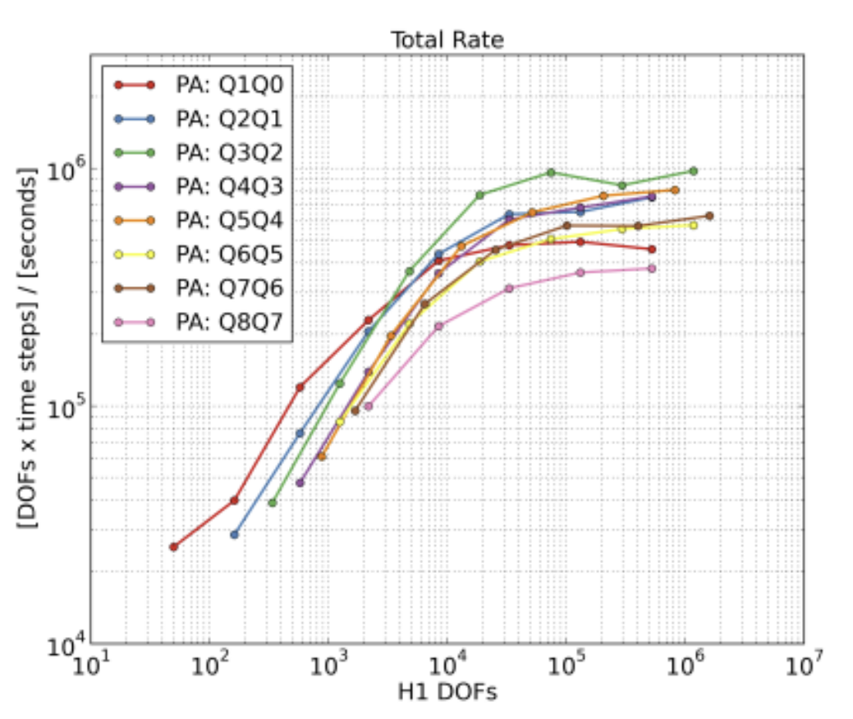
Literature Review: Paper 1
Figure 3: Quadrature point update. CPU left, GPU right.
Figure 4: Total rate for major kernels. Only CPU graph was published.

Slide 16
Results: Taylor-Green Problem--Rate

Slide 17
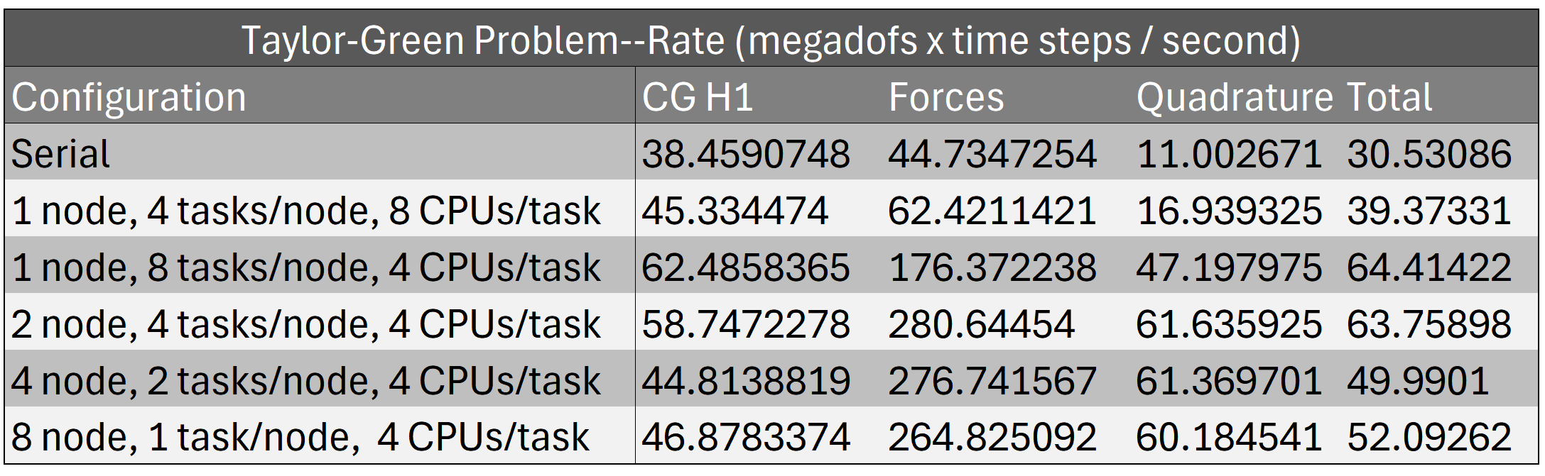
Results: Taylor-Green Problem--Rate

Slide 18
Results: Taylor-Green Problem--Time

Slide 19
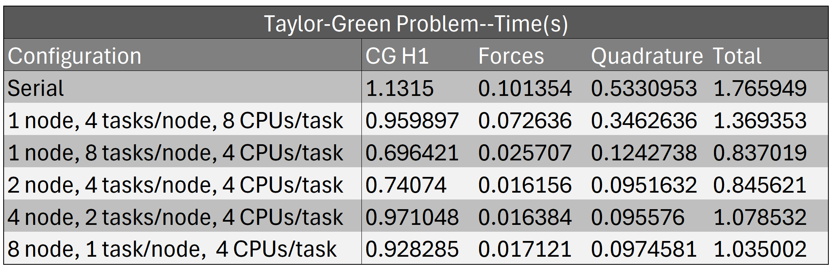
Results: Taylor-Green Problem--Time

Slide 20
Literature Review: Paper 2
Title: Efficient Exascale Discretizations: High-Order Finite Element Methods
Purpose for technical report:
Overview of the research and development activities in CEED
Discuss performance optimizations for large-scale GPU architectures
Relevance:
Section on the large-scale GPU runs of Laghos
Sedov Blast Problem
Hardware:
Lassen machine at Lawrence Livermore National Laboratory (LLNL)
2 22-core IBM Power9 CPUs per node, with 40 usable cores
4 NVIDIA Volta V100 GPUs per node

Slide 21
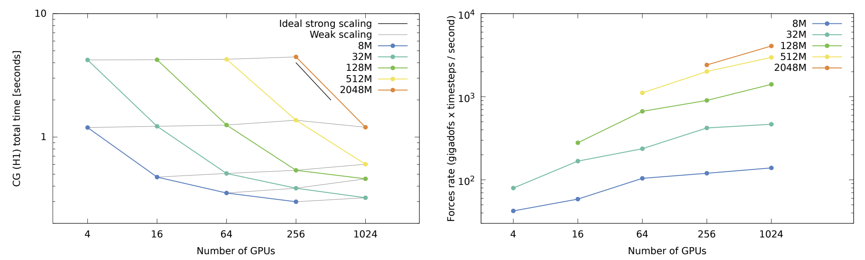
Literature Review: Paper 2
Figure 5: CG H1 time results on left, Forces rate on right. Legend describes weak and strong scaling as well as computation size

Slide 22
Results: Sedov Blast Problem--Time

Slide 23
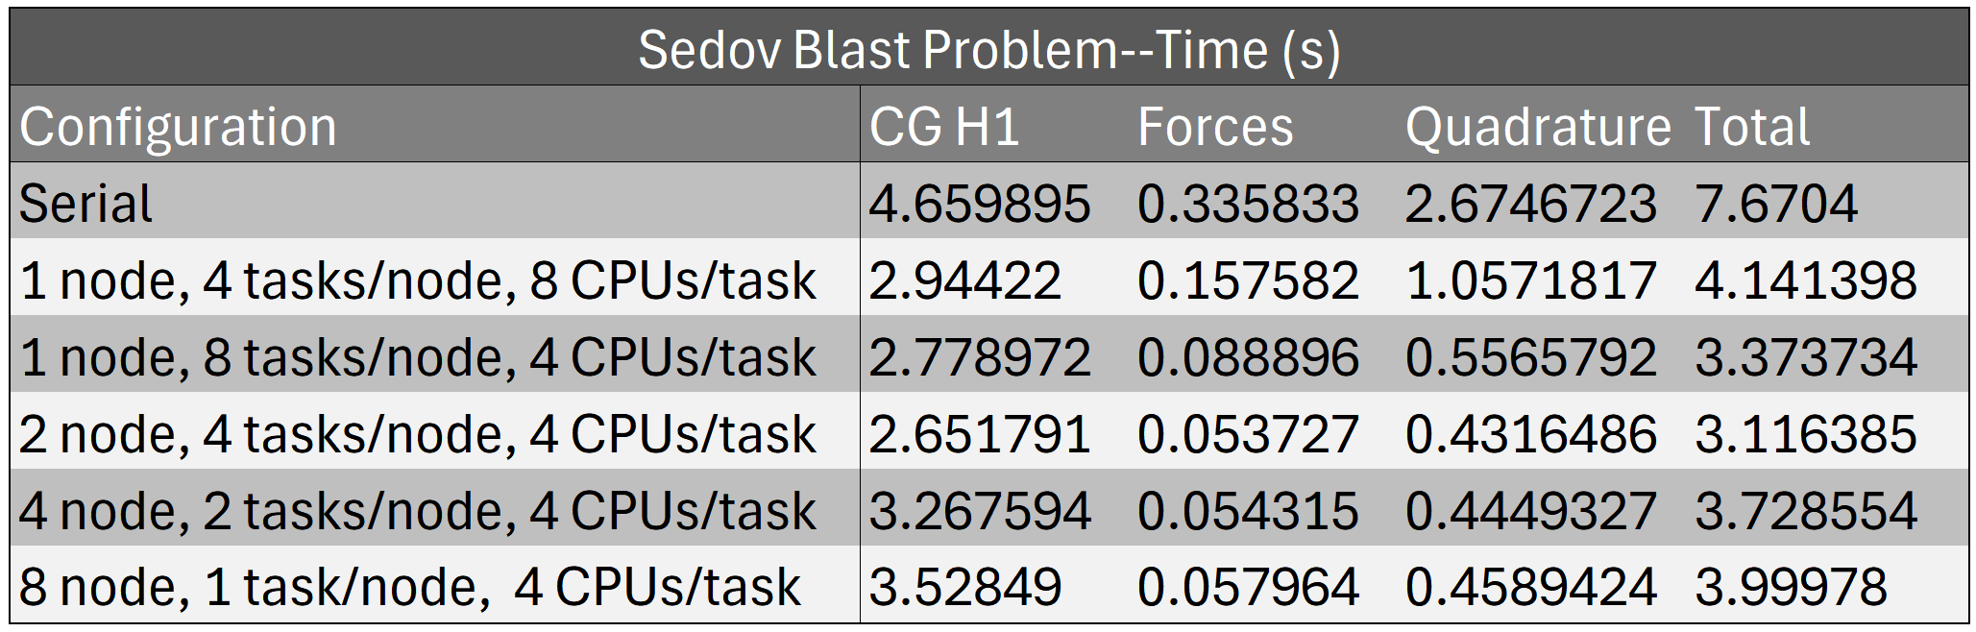
Results: Sedov Blast Problem--Time

Slide 24
Results: Sedov Blast Problem--Rate

Slide 25
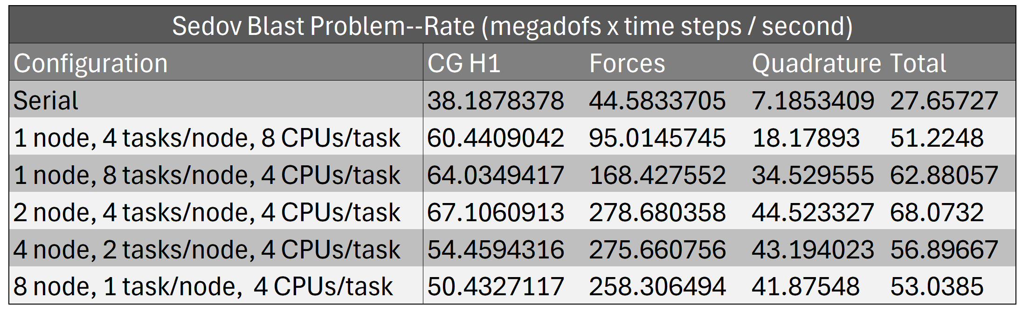
Results: Sedov Blast Problem--Rate

Slide 26
Sedov Blast Problem: MPI vs MPI+OPENMP vs CUDA
Average of 10 runs on HiperGator
Run | 1 Node, 4 Tasks/node , 8 CPUs per task |  | 1 Node, 4 Tasks/node , 8 CPUs per task, 2 Threads |  | 1 Node, 4 Tasks/node , 8 CPUs per task, 4 Threads |  | 1 Node, 4 Tasks/node , 8 CPUs per task, 8 Threads |  | GPU(cuda)
1 | 43.04 | 4.93 | 31.46 | 6.74 | 20.01 | 10.6 | 14.44 | 14.69 | 9.6 | 22.09
2 | 42.92 | 4.94 | 41.85 | 5.07 | 20.07 | 10.57 | 18.69 | 11.35 | 9.47 | 22.39
3 | 42.91 | 4.94 | 41.66 | 5.09 | 20.81 | 10.19 | 13.91 | 15.25 | 9.53 | 22.24
4 | 42.87 | 4.96 | 38.97 | 5.44 | 19.96 | 10.62 | 22.12 | 9.59 | 9.55 | 22.19
5 | 42.98 | 4.93 | 39.62 | 5.35 | 23.91 | 8.87 | 21.87 | 6.99 | 9.48 | 22.37
6 | 42.91 | 4.94 | 33.58 | 6.31 | 26.41 | 8.03 | 27.37 | 7.75 | 9.55 | 22.21
7 | 42.97 | 4.93 | 33.16 | 6.39 | 23.29 | 9.11 | 27.47 | 7.72 | 9.56 | 22.19
8 | 38.62 | 5.49 | 43.19 | 4.91 | 20.02 | 10.59 | 14 | 15.15 | 9.57 | 22.12
9 | 42.8 | 4.96 | 43.1 | 4.92 | 20.069 | 10.57 | 14.37 | 14.77 | 9.58 | 22.12
10 | 42.9 | 4.94 | 43.04 | 4.93 | 28.67 | 7.39 | 14.09 | 15.06 | 9.55 | 22.2
Average | 42.492 | 4.996 | 38.963 | 5.515 | 22.3219 | 9.654 | 18.83 | 11.83 | 9.544 | 22.212
*Left columns show time in seconds. Right columns show Megadofs x timesteps/second

Slide 27
Gprof Profiling
Ported, run, profiled, and analyzed LAGHOS (serial) in HiPerGator with gprof:
% cumulative self self total ms/
time seconds seconds calls ms/call call name
30.66 2.26 2.26 44226560 0.00 0.00 PAMassApply2D_Element
28.90 4.39 2.13 19218432 0.00 0.00 QUpdateBody
11.67 5.25 0.86 186822 0.00 0.00 Mult
10.85 6.05 0.80 177436 0.00 0.00 TAddMultTranspose
… … … … … … …
2.58 6.70 0.19 9384 0.02 0.02 TensorDerivatives

Slide 28
Gprof Profiling
Ported, run, profiled, and analyzed LAGHOS (MPI) in HiPerGator with gprof:
1 nodes, 4 tasks/node (4 total tasks), 8 CPUs/task (32 CPUs total)
% cumulative self self total ms/
time seconds seconds calls ms/call call name
20.78 0.91 0.91 2402304 0.00 0.00 QUpdateBody
20.55 1.81 0.90 186785 0.00 0.00 PAMassApply
20.32 2.70 0.89 186824 0.00 0.00 Mult
14.16 3.32 0.62 177436 0.00 0.00 MultTranspose
7.76 3.66 0.34 9384 0.02 0.02 TensorDerivatives

Slide 29
Gprof Profiling
Ported, run, profiled, and analyzed LAGHOS (MPI) in HiPerGator with gprof:
1 nodes, 8 tasks/node (8 total tasks), 4 CPUs/task (32 CPUs total)
% cumulative self self total ms/
time seconds seconds calls ms/call call name
23.50 0.43 0.43 2402304 0.00 0.00 QUpdateBody
16.94 0.74 0.31 186785 0.00 0.00 PAMassApply
16.39 1.04 0.30 186824 0.00 0.00 Mult
12.57 1.27 0.23 177436 0.00 0.00 MultTranspose
6.01 1.38 0.11 9384 0.01 0.01 TensorDerivatives

Slide 30
Gprof Profiling
Ported, run, profiled, and analyzed LAGHOS (MPI) in HiPerGator with gprof:
2 nodes, 4 tasks/node (8 total tasks), 4 CPUs/task (32 CPUs total)
% cumulative self self total ms/
time seconds seconds calls ms/call call name
22.39 0.30 0.30 2402304 0.00 0.00 QUpdateBody
18.66 0.55 0.25 186785 0.00 0.00 PAMassApply
17.91 0.79 0.24 186824 0.00 0.00 Mult
17.16 1.02 0.23 177436 0.00 0.00 MultTranspose
9.70 1.15 0.13 9384 0.01 0.01 TensorDerivatives

Slide 31
Gprof Profiling
Ported, run, profiled, and analyzed LAGHOS (MPI) in HiPerGator with gprof:
4 nodes, 2 tasks/node (8 total tasks), 4 CPUs/task (32 CPUs total)
% cumulative self self total ms/
time seconds seconds calls ms/call call name
25.66 0.29 0.29 2402304 0.00 0.00 QUpdateBody
18.58 0.50 0.21 186785 0.00 0.00 PAMassApply
13.27 0.65 0.15 186824 0.00 0.00 Mult
10.62 0.77 0.12 177436 0.00 0.00 MultTranspose
9.73 0.88 0.11 9384 0.01 0.01 TensorDerivatives

Slide 32
Gprof Profiling
Ported, run, profiled, and analyzed LAGHOS (MPI) in HiPerGator with gprof:
8 nodes, 1 tasks/node (8 total tasks), 4 CPUs/task (32 CPUs total)
% cumulative self self total ms/
time seconds seconds calls ms/call call name
32.17 0.37 0.37 2402304 0.00 0.00 QUpdateBody
20.00 0.60 0.23 186785 0.00 0.00 PAMassApply
13.04 0.75 0.15 186824 0.00 0.00 Mult
6.09 0.82 0.07 177436 0.00 0.00 MultTranspose
6.09 0.89 0.07 9384 0.01 0.01 TensorDerivatives

Slide 33
Nvprof profiling
==1434484== Profiling application: ./laghos -p 1 -dim 2 -rs 3 -tf 0.8 -pa -d cuda
==1434484== Profiling result:
Type Time(%) Time Calls Avg Min Max Name
GPU activities: 17.43% 1.06600s 369130 2.8870us 2.7840us 3.1690us mfem::cuKernelDot(int, double*, double const *, double const *)
14.27% 872.83ms 524117 1.6650us 1.5990us 2.0480us _ZN4mfem10CuKernel1DIZNS
12.42% 759.50ms 172760 4.3960us 4.3510us 4.6710us _ZN4mfem10CuKernel2DIZNS_8internal17SmemPAMassApply2D
11.52% 704.62ms 177436 3.9710us 3.7760us 6.1760us_ZN4mfem10CuKernel1DIZNKS
8.01% 489.89ms 373832 1.3100us 1.2790us 3.9360us [CUDA memcpy DtoH]
7.84% 479.61ms 387619 1.2370us 1.1830us 1.5360us _ZN4mfem10CuKernel1DIZNS_6VectoraSEdEUliE_EEviT_
5.85% 357.72ms 186824 1.9140us 1.8240us 2.7840us _ZN4mfem10CuKernel1DIZNKS_
5.21% 318.75ms 225381 1.4140us 1.3440us 1.6960us [CUDA memcpy DtoD]
4.76% 291.33ms 172760 1.6860us 1.6630us 1.9200us _ZN4mfem10CuKernel1DIZNKS_22OperatorJacobiSmoother
4.40% 268.96ms 182112 1.4760us 1.4070us 1.6640us _ZN4mfem10CuKernel1DIZNS_6Vector12SetSubVector
1.90% 115.98ms 4692 24.718us 21.407us 25.376us _ZN4mfem10CuKernel2DIZNS_13hydrodynamics

Slide 34
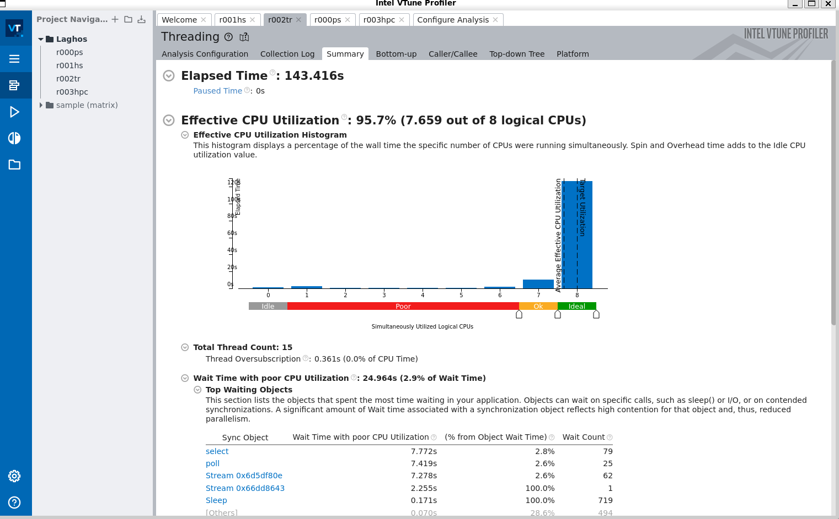
Vtune Profiling
Intel's profiling system used to identify memory consumption and trace callbacks in threaded applications
Problem one (Sedov Blast) was run using Laghos on a local computer
Serial + OpenMP (15 Threads)

Slide 35
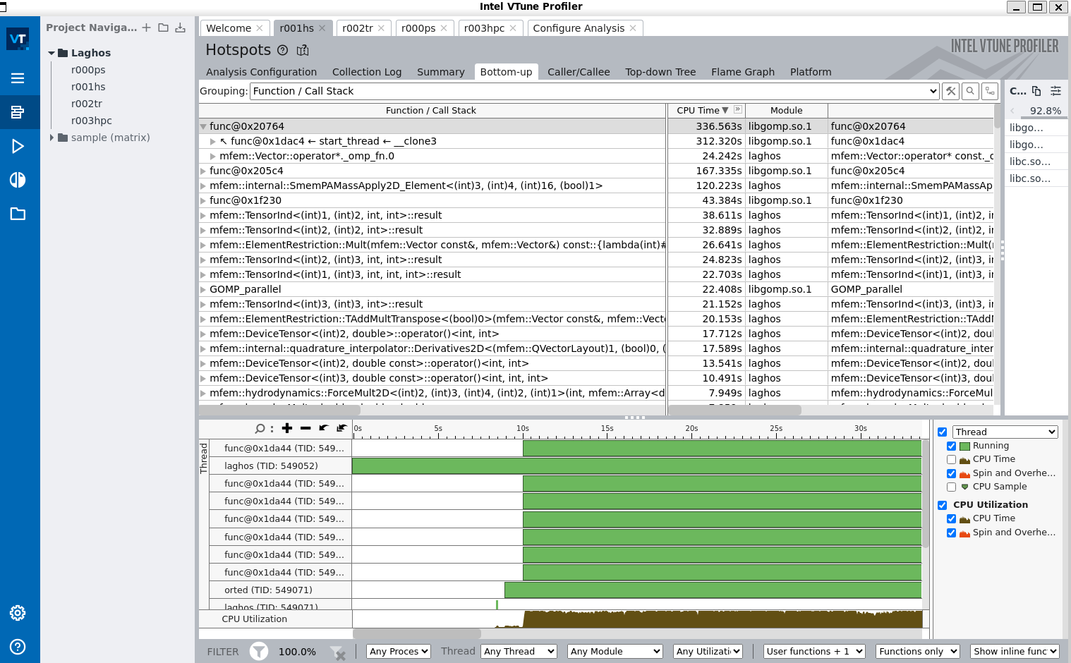
Hotspots
Results are similar to gprof profiling, with functions such as memPAMassApply2D() taking most of the cpu time.

Slide 36
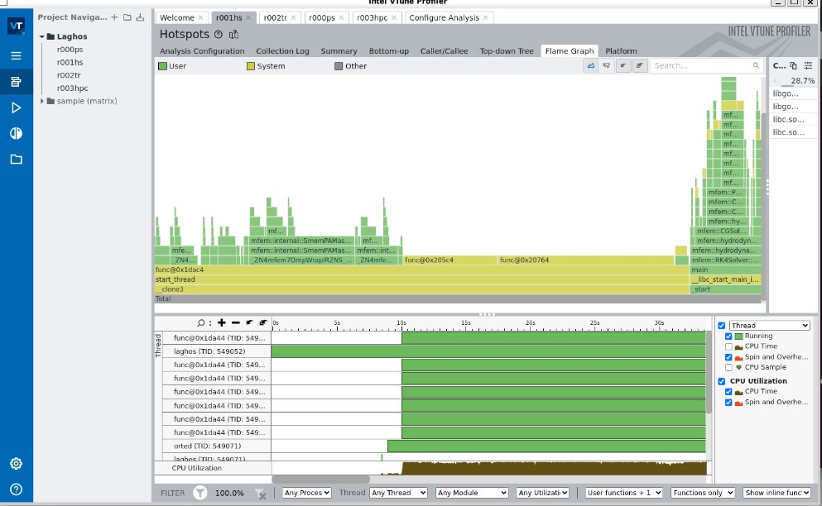
Hotspots- Flame Graph

Slide 37
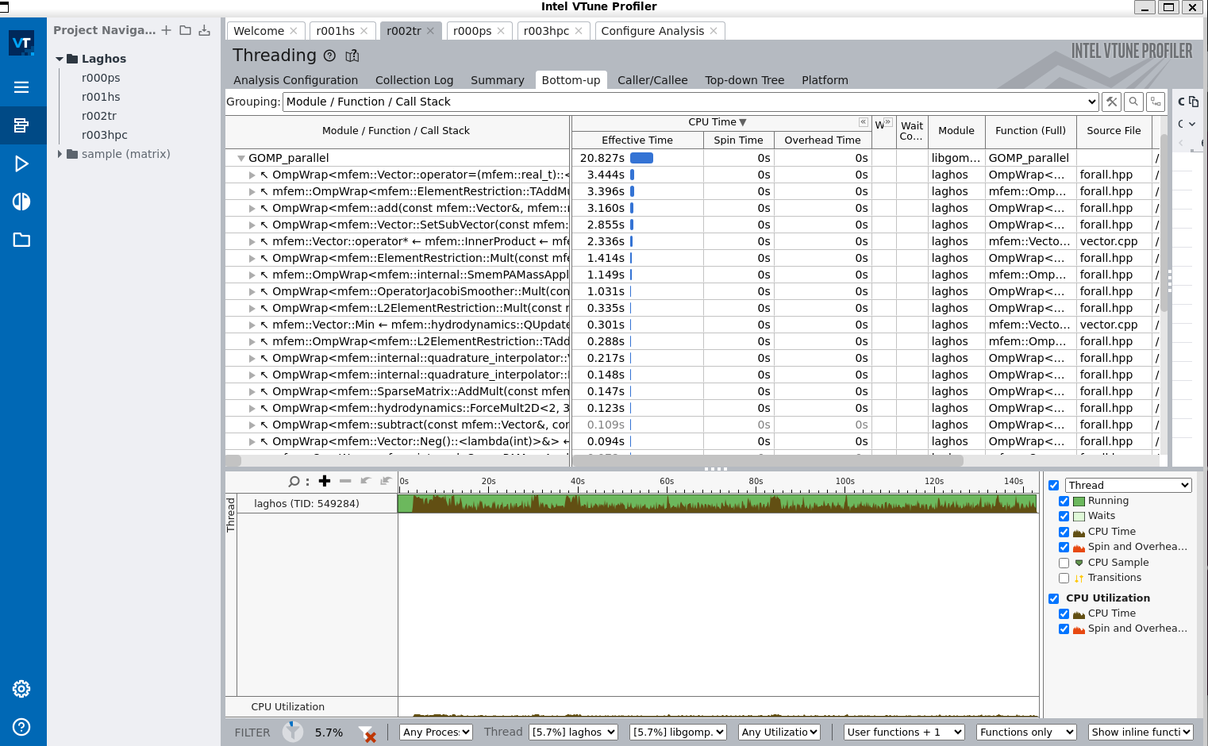
Single Thread Call Stack
Call Stack of the MFEM library
Single thread spends most time in the OmpWrap and Vector functions
The graph on the bottom shows CPU usage over the time the thread is active

Slide 38
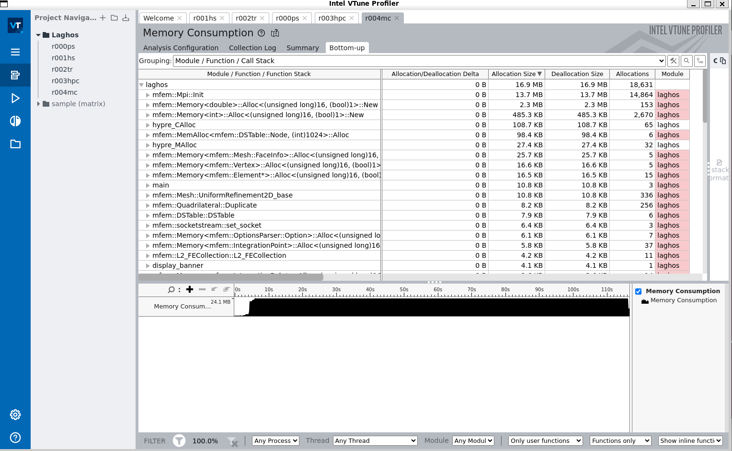
Memory Consumption

Slide 39
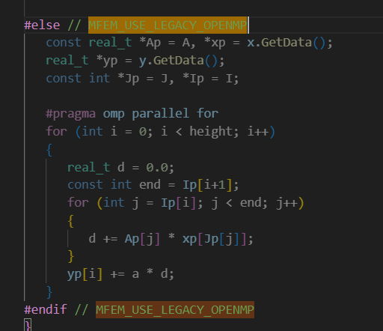
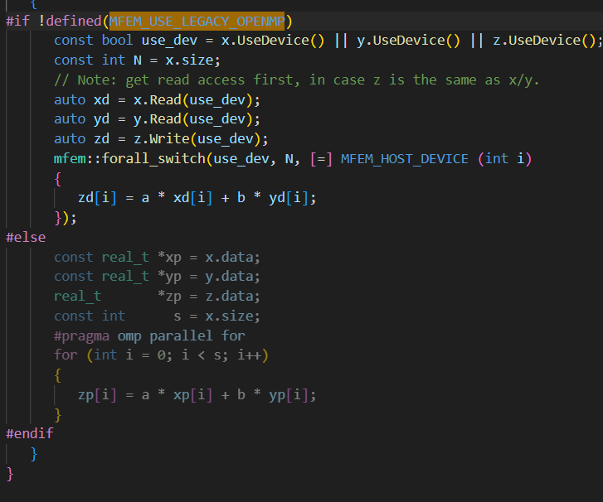
OpenMP code configuration
When looking in the MFEM library, examples of OpenMP code can be seen when using the "MFEM_USE_LEGACY_OPENMP" directive

Slide 40
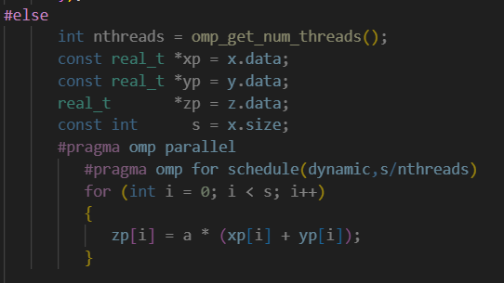
OpenMP code configuration

Slide 41
OpenMP code configuration
Run | No Changes | (Dynamic,N/numThreads) | (Dynamic,10)
1 | 19.65 s | 24.27 s | 21.10 s
2 | 19.33 s | 22.29 s | 21.12 s
3 | 19.21 s | 20.69 s | 21.14 s
4 | 19.81 s | 22.74 s | 22.65 s
5 | 19.71 s | 20.83 s | 21 s
Average | 19.54 | 22.16 s | 21.40 s

Slide 42
Summary (2 slides)
Background
Gave overview on LAGHOS
Explained the problems within LAGHOS that we ran on HiPerGator
Explained the context of the results LAGHOS calculates on each run
Code Review
Explained the structure of the code as well as how it was parallelized with both MPI and OpenMP examples
Literature Review (2 papers)
Gave background context for each paper (purpose, relevance, and hardware) and reviewed the results for both papers
Ported results to HiPerGator, compared to published results
Results performed comparably to the first paper, running a little higher or lower in each plot, but our results showed better performance for the Forces operator problem.
Results performed at the capacity of ~64 GPUs in the 2nd paper in one test, given our problem size of ~200M, and were outperformed each configuration of the paper in the second test
Ran MPI, MPI+OpenMP, and CUDA code on HiPerGator, best performance with MPI was with 1 node, 8 tasks, and 4 CPUs/task, CUDA was best performing overall.
Please see report for a more detailed analysis on the results.

Slide 43
Summary (2 slides)
Gprof Profiling
Showed the majority of time was spent in the MFEM library, which is where we decided to edit the code.
Explained how the function calls were consistent among different configurations of MPI runs because the number of CPUs stayed the same
Nvprof Profiling
Laghos was run with the CUDA backend enabled on HiperGator by requesting GPU resources.
Nvprof showed extensive use of the CUDA kernels in the MFEM library used to replace the MPI functions.
A large amount of time was also spent allocating memory (malloc/calloc)
Vtune Profiling
Laghos with OpenMP backend enabled was run off of HigerGator, on a local intel machine in WSL (Windows Subsystem for Linux). The problem ran with 15 threads. Specifically focused on HotSpots and memory consumption
Results were comparable to Gprof, the hotspots were some of the same MFEM functions
Individual threads spent most of the time in vector addition functions in MFEM.
Changed OpenMP Code
In the MFEM Library, the vector addition functions were some of the only places where OpenMP code could be seen and altered.
These functions used default static scheduling for the OpenMP parallel loop, this was changed to dynamic scheduling, and the chunk size was changed from the default (N/numThreads) to constant values to see difference in performace
Dynamic scheduling performed slightly worse than static, possibly due to overhead or the regular workload of the problems run in Laghos
Demo (Next slide)
Demo of MPI version of Laghos and MPI+OpenMP version (OpenMP enabled through the MFEM library)

Slide 44
Deliverables and demo plans
Demo plans:
Demonstrated building and running MPI code with gprof profiler
Repeated with altered MPI+OpenMP code

Slide 45
References
https://github.com/CEED/Laghos
Initial Integration of CEED Software in ECP Applications
[2109.04996] Efficient Exascale Discretizations: High-Order Finite Element Methods (arxiv.org)
https://ceed.exascaleproject.org/software/
https://mfem.org/

